Slide 1
Value Decomposition
Singular

Slide 2
PROBLEM VS SOLUTION
Problem
Solution
How many times have we faced this issue? We love clicking images with our smartphone cameras and saving random photos off the web. And then one day – no space! Image compression helps deal with that headache.
Ever clicked an image in low light? Or had an old image become corrupt? We assume that we cannot get that image back anymore. It’s surely lost to the past. Well, no . Image recovery can help you .
Singular Value Decomposition

Slide 3
Singular Value Decomposition
You just need to know four things to understand :
SVD is the decomposition of a matrix A into 3 matrices – U, S, and V.
S is the diagonal matrix of singular values. Think of singular values as the importance values of different features in the matrix
The rank of a matrix is a measure of the unique information stored in a matrix. Higher the rank, more the information.
Eigenvectors of a matrix are directions of maximum spread or variance of data
In most of the applications of SVD, the basic principle of Dimensionality Reduction is used. You want to reduce a high-rank matrix to a low-rank matrix while preserving important information.

Slide 4
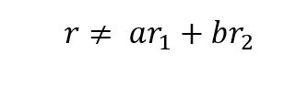
Rank Of Matrix
Before SVD , we need to know rank of matrix
The rank of a matrix is the maximum number of linearly independent row (or column) vectors in the matrix. A vector r is said to be linearly independent of vectors r1 and r2 if it cannot be expressed as a linear combination of r1 and r2.

Slide 5
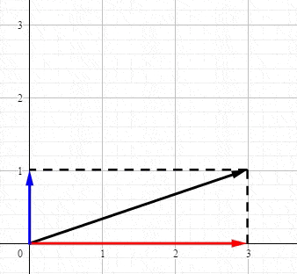
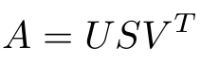
Singular Value Decomposition
So where does SVD fit into the overall picture? SVD deals with decomposing a matrix into a product of 3 matrices as shown:
If the dimensions of A are m x n:
U is an m x m matrix of Left Singular Vectors
S is an m x n rectangular diagonal matrix of Singular Values arranged in decreasing order
V is an n x n matrix of Right Singular Vectors

Slide 6
To summarize:
Using SVD, we are able to represent our large matrix A by 3 smaller matrices U, S and V.
This is helpful in large computations.
We can obtain a k-rank approximation of A. To do this, select the first k singular values and truncate the 3 matrices accordingly.
Singular Value Decomposition(SVD) is one of the most widely used Unsupervised learning algorithms, that is at the center of many recommendation and Dimensionality reduction systems that are the core of global companies such as Google, Netflix, Facebook, Youtube, and others.

Slide 7
What Is Decomposition Reduction?
Dimensionality reduction refers to reducing the number of input variables for a dataset.
If your data is represented using rows and columns, such as in a spreadsheet, then the input variables are the columns that are fed as input to a model to predict the target variable. Input variables are also called features.
We can consider the columns of data representing dimensions on an n-dimensional feature space and the rows of data as points in that space. This is a useful geometric interpretation of a dataset.
Having a large number of dimensions in the feature space can mean that the volume of that space is very large, and in turn, the points that we have in that space (rows of data) often represent a small and non-representative sample.
This can dramatically impact the performance of machine learning algorithms fit on data with many input features, generally referred to as the “curse of dimensionality.”

Slide 8
What Is Decomposition Reduction?
Therefore, it is often desirable to reduce the number of input features. This reduces the number of dimensions of the feature space, hence the name “dimensionality reduction.”
Singular Value Decomposition, or SVD, might be the most popular technique for dimensionality reduction when data is sparse.
Sparse data refers to rows of data where many of the values are zero. This is often the case in some problem domains like recommender systems where a user has a rating for very few movies or songs in the database and zero ratings for all other cases. Another common example is a bag of words model of a text document, where the document has a count or frequency for some words and most words have a 0 value.

Slide 9
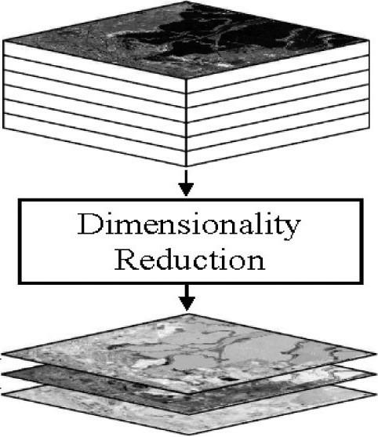

Slide 10
Application Of SVD
Image Compression
Image Recovery
Eigenfaces
Spectral Clustering
Background Removal from Videos
Recommender Systems
Customer-Product purchases
User-Song Listen Counts
User-Movie Ratings
Text Classification
One Hot Encoding
Bag of Words Counts
TF/IDF

Slide 11
bEFORE MOVING FURTHER, FIRST WE NEED TO LEARN ABOUT Eigenvalues AND EigenVectors
Eigenvalues are associated with eigenvectors in Linear algebra. Both terms are used in the analysis of linear transformations.
Eigenvalues are the special set of scalar values that is associated with the set of linear equations most probably in the matrix equations. The eigenvectors are also termed as characteristic roots.
It is a non-zero vector that can be changed at most by its scalar factor after the application of linear transformations. And the corresponding factor which scales the eigenvectors is called an eigenvalue.

Slide 12
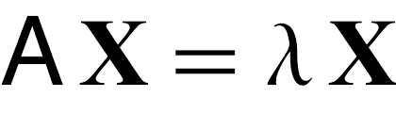
Eigenvalue
Eigenvalues are the special set of scalars associated with the system of linear equations. It is mostly used in matrix equations. ‘Eigen’ is a German word that means ‘proper’ or ‘characteristic’. Therefore, the term eigenvalue can be termed as characteristic value, characteristic root, proper values or latent roots as well. In simple words, the eigenvalue is a scalar that is used to transform the eigenvector. The basic equation is
The number or scalar value “λ” is an eigenvalue of A.

Slide 13
In Mathematics, an eigenvector corresponds to the real non zero eigenvalues which point in the direction stretched by the transformation whereas eigenvalue is considered as a factor by which it is stretched. In case, if the eigenvalue is negative, the direction of the transformation is negative.
For every real matrix, there is an eigenvalue. Sometimes it might be complex. The existence of the eigenvalue for the complex matrices is equal to the fundamental theorem of algebra.

Slide 14
Eigenvectors
Eigenvectors are the vectors (non-zero) that do not change the direction when any linear transformation is applied. It changes by only a scalar factor. In a brief, we can say, if A is a linear transformation from a vector space V and x is a vector in V, which is not a zero vector, then v is an eigenvector of A if A(X) is a scalar multiple of x.
An Eigenspace of vector x consists of a set of all eigenvectors with the equivalent eigenvalue collectively with the zero vector. Though, the zero vector is not an eigenvector.

Slide 15
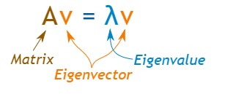
Let us say A is an “n × n” matrix and λ is an eigenvalue of matrix A, then x, a non-zero vector, is called as eigenvector if it satisfies the given below expression;
Ax = λx
x is an eigenvector of A corresponding to eigenvalue, λ.
Note:
There could be infinitely many Eigenvectors, corresponding to one eigenvalue.
For distinct eigenvalues, the eigenvectors are linearly dependent.

Slide 16
Eigenvalues of a Square Matrix
Suppose, An×n is a square matrix, then [A- λI] is called an Eigen or characteristic matrix, which is an indefinite or undefined scalar. Where determinant of Eigen matrix can be written as, |A- λI| and |A- λI| = 0 is the Eigen equation or characteristics equation, where “I” is the identity matrix. The roots of an Eigen matrix are called Eigen roots.
Eigenvalues of a triangular matrix and diagonal matrix are equivalent to the elements on the principal diagonals. But eigenvalues of the scalar matrix are the scalar only.

Slide 17
Properties of EigenvalueS
Eigenvectors with Distinct Eigenvalues are Linearly Independent
Singular Matrices have Zero Eigenvalues
If A is a square matrix, then λ = 0 is not an eigenvalue of A
For a scalar multiple of a matrix: If A is a square matrix and λ is an eigenvalue of A. Then, aλ is an eigenvalue of aA.
For Matrix powers: If A is square matrix and λ is an eigenvalue of A and n≥0 is an integer, then λn is an eigenvalue of An.
For polynomials of matrix: If A is a square matrix, λ is an eigenvalue of A and p(x) is a polynomial in variable x, then p(λ) is the eigenvalue of matrix p(A).
Inverse Matrix: If A is a square matrix, λ is an eigenvalue of A, then λ-1 is an eigenvalue of A-1
Transpose matrix: If A is a square matrix, λ is an eigenvalue of A, then λ is an eigenvalue of At

Slide 18
aPPLICATION OF Eigenvalues and Eigenvectors of a square matrix
1. Communication systems: Eigenvalues determine the theoretical limit to how much information can be transmitted through a communication medium like your telephone line or through the air. This is done by calculating the eigenvectors and eigenvalues of the communication channel (expressed a matrix), and then waterfilling on the eigenvalues. The eigenvalues are then, in essence, the gains of the fundamental modes of the channel, which themselves are captured by the eigenvectors.
2. Designing bridges: The natural frequency of the bridge is the eigenvalue of smallest magnitude of a system that models the bridge. The engineers exploit this knowledge to ensure the stability of their constructions.

Slide 19
aPPLICATION OF Eigenvalues and Eigenvectors of a square matrix
3. Designing car stereo system: Eigenvalue analysis is also used in the design of the car stereo systems, where it helps to reproduce the vibration of the car due to the music.
4. Mechanical Engineering: Eigenvalues and eigenvectors allow us to "reduce" a linear operation to separate, simpler, problems. For example, if a stress is applied to a "plastic" solid, the deformation can be dissected into "principle directions"- those directions in which the deformation is greatest. Vectors in the principle directions are the eigenvectors and the percentage deformation in each principle direction is the corresponding eigenvalue

Slide 20
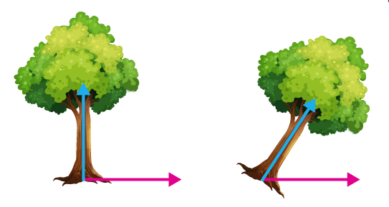
EigenValue Example
In this shear mapping, the blue arrow changes direction, whereas the pink arrow does not. Here, the pink arrow is an eigenvector because it does not change direction. Also, the length of this arrow is not changed; its eigenvalue is 1.

Slide 21

Eigenvalues of 2 x 2 Matrix
Let us have a look at the example given below to learn how to find the eigenvalues of a 2 x 2 matrix.
Find the eigenvalues of the 2 x 2 matrix
Solution:
Given,
Using the characteristic equation,
Let
be the 2 x 2 identity matrix.
|A – λI| = 0

Slide 22
-λ(4 – λ) – (-2)(0) = 0
-4λ + λ2 = 0
λ(λ – 4) = 0
λ = 0 or λ – 4 = 0
Thus, λ = 0 or λ = 4
Hence, the two eigenvalues of the given matrix are λ = 0 and λ = 4.

Slide 23

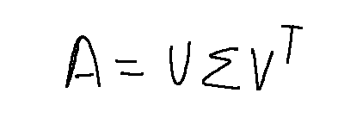
Working Example OF svd
According to the formula for SVD,
A is the input matrix
U are the left singular vectors,
sigma are the diagonal/eigenvalues
V are the right singular vectors.
The shape of these three matrices will be
A — m x n matrix
U — m x k matrix
Sigma — k x k matrix
V — n x k matrix

Slide 24
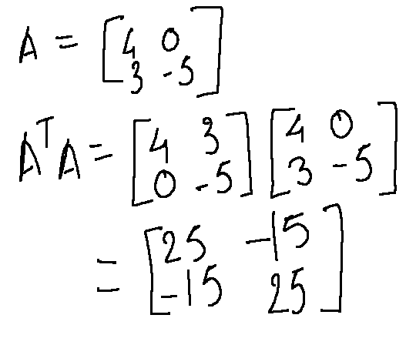
Working Example
Step 1
First we need to find eigenvalues of matrix A and as A can be a rectangular matrix, we need to convert it to a square matrix by multiplying A with its transpose. Here, for easier computation I have taken A as a 2 x 2 matrix.

Slide 25
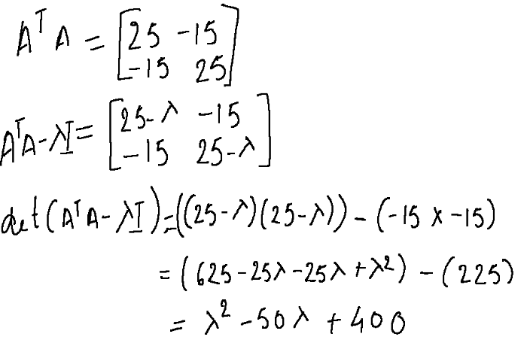
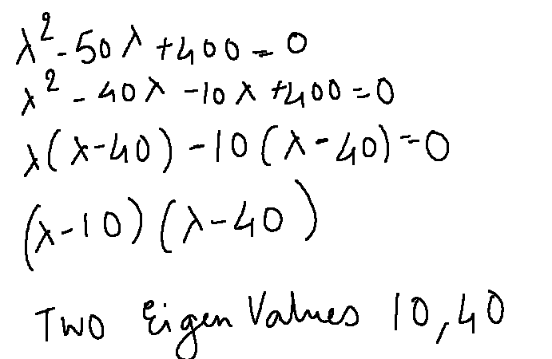
Step 2
Now, we have a square matrix, we can calculate the eigenvalues of A(transpose) A. We, can do so by calculating the determinant of A(transpose)A — (lambda)I where lambda are the two eigenvalues.
Solving the equation, we get

Slide 26
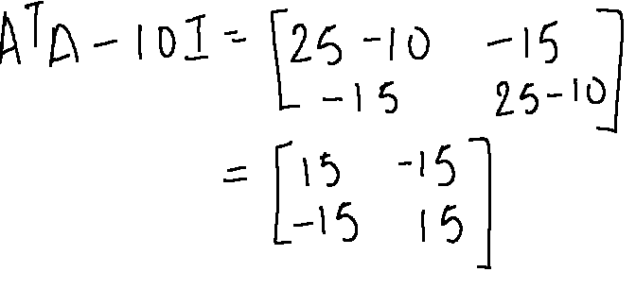
Working Example
Step 3
Once we have calculated the eigenvalues, it’s time to calculate the two eigenvectors for each eigenvalue. So, let’s start by calculating the eigenvector for 10.
Step 3.1
We plug the value of lambda in the A(transpose)A — (lambda)I matrix.

Slide 27
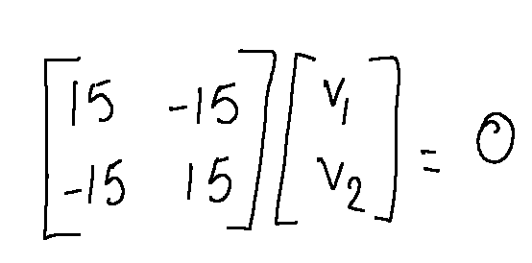
Working Example
In order to find the eigenvector, we need to find the null space of a matrix where AB = 0.
Next, we need to reduce this matrix to the Row-Echelon Form so that we can easily solve the equation.
Row-Echelon Form
A matrix is said to be in row-echelon form if the following rules are satisfied.
All the leading entries in each row of the matrix is 1
If a column contains a leading entry then all the entries below the leading entry should be zero
If any two consecutive non-zero rows, the leading entry in the upper row should occur to the left of the leading entry in the lower row.
All rows which consist only of zeros should occur in the bottom of the matrix.

Slide 28
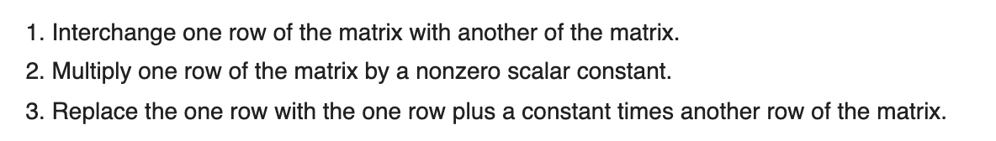
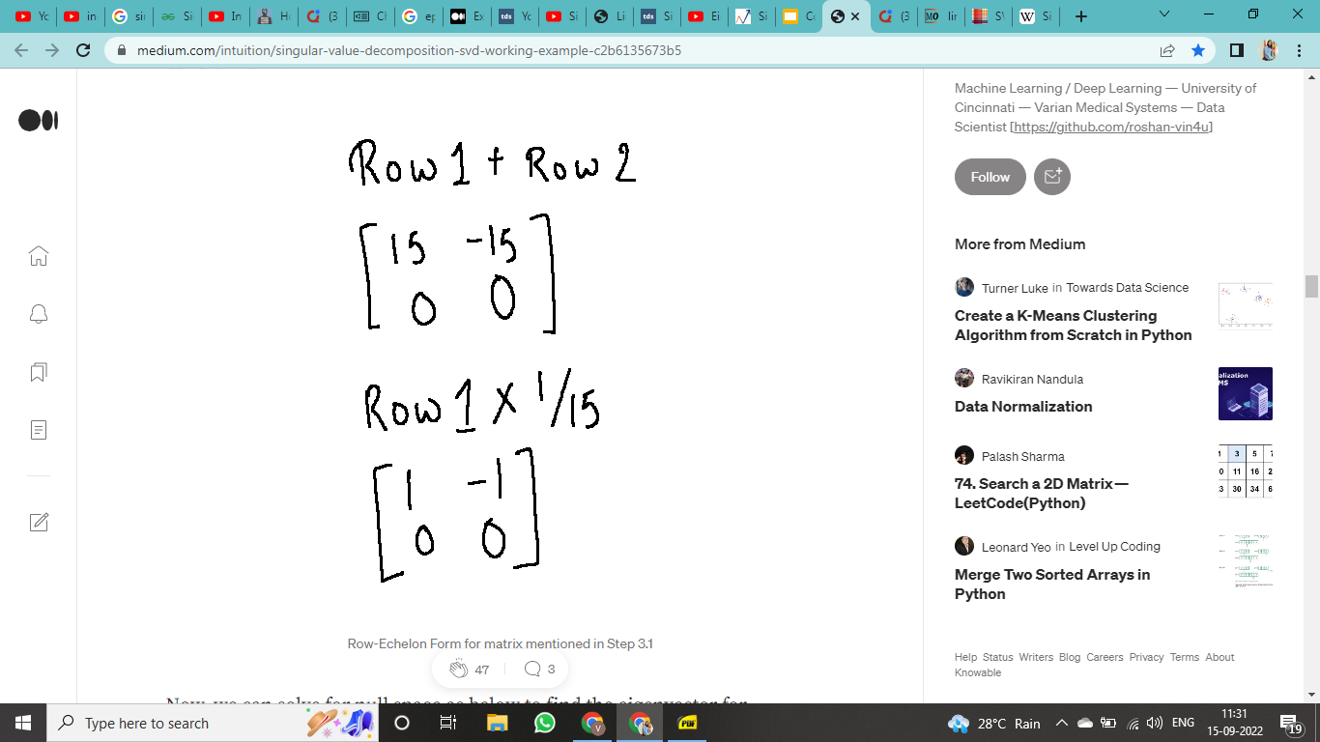
Working Example
We need to perform some operations on the rows to reduce the matrix. These operations are called elementary row operations and there are a certain rules to follow for these operations as given below,
Armed with the above rules, let’s start reducing the matrix in Step 3.1 to row-echelon form.

Slide 29
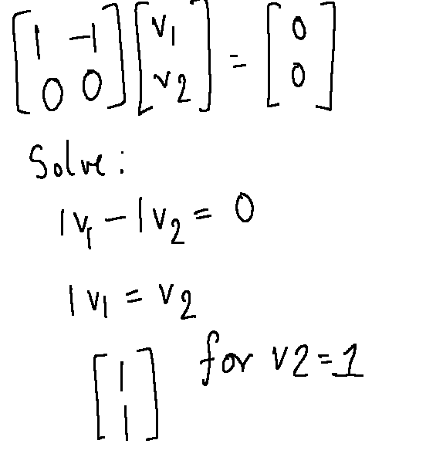
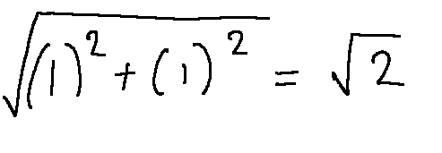
Working Example
Now, we can solve for null space as below to find the eigenvector for eigenvalue 10
Once we get this vector, we need to convert it to a unit vector . The way we do that is by taking the columnar values and dividing them by taking the square root of the sum of squares of the values. So, in this case we do the following.

Slide 30
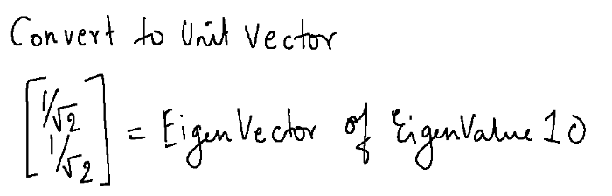
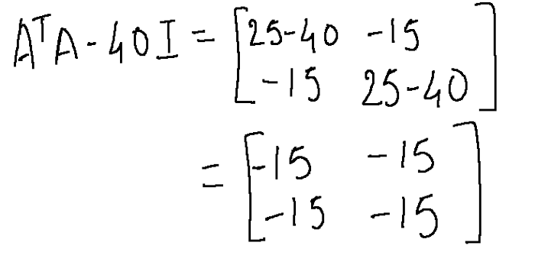
So the final eigenvector for eigenvalue is
We do the similar steps to get the eigenvector for eigenvalue 40

Slide 31
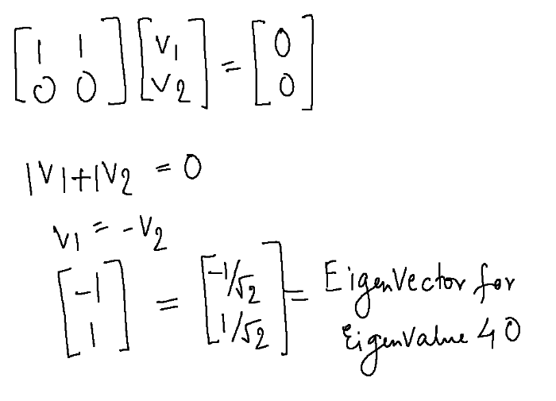
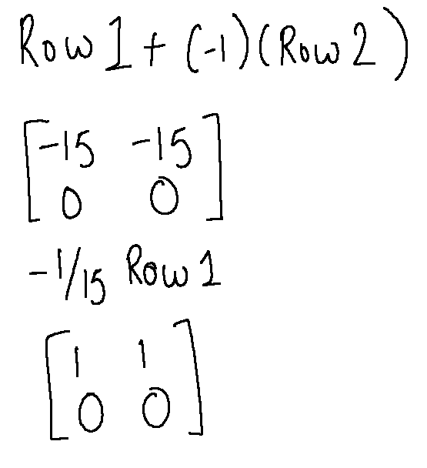
Working Example
EigenVector for 40
Row echelon form

Slide 32
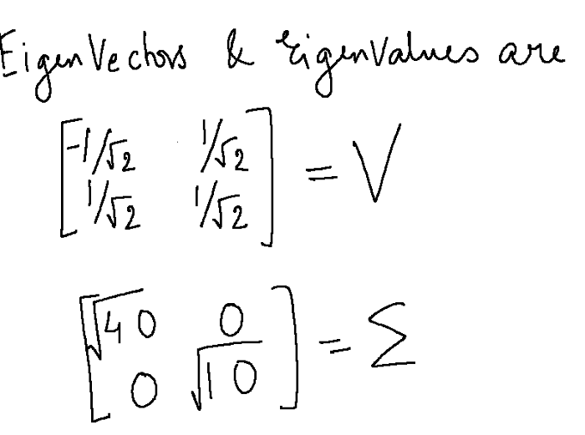
Working Example
Now that we have got both the eigenvectors, let’s put it together.
Note that the diagonal values in sigma are always in the descending order and so the vectors are also placed in that corresponding order.

Slide 33
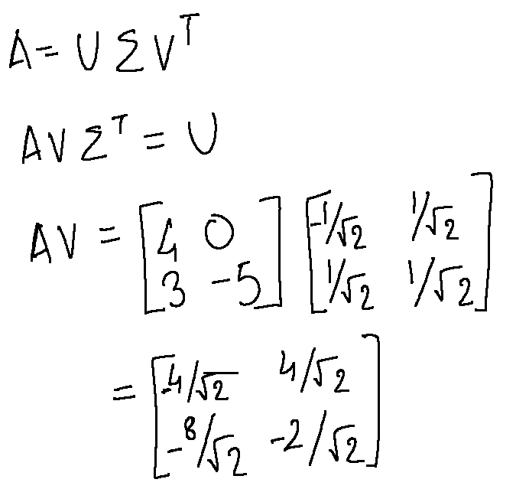
Working Example
Step 4 -
Now that we have our V and Sigma matrices, now it’s time to find U. We can just multiply the equation by sigma(inverse) and V on both sides to get the equation for U. In this case, as V is an orthogonal matrix, the transpose and inverse of V are the same, therefore, V(transpose) multiplied by V becomes an identity matrix. Same goes, for the diagonal matrix as well.

Slide 34
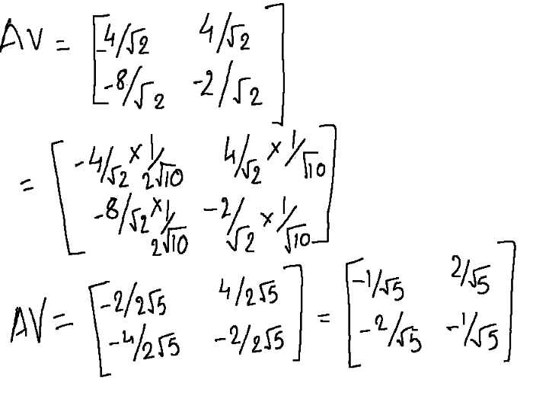
Working Example
Next up, we need to convert this to unit vectors using the steps described above.

Slide 35
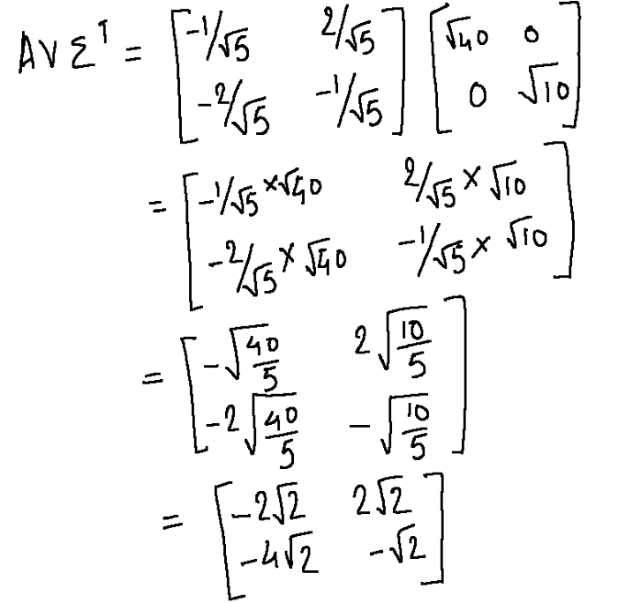
Working Example
Next up we multiply this matrix with Sigma (transpose) which is sigma in itself because its a diagonal matrix.

Slide 36
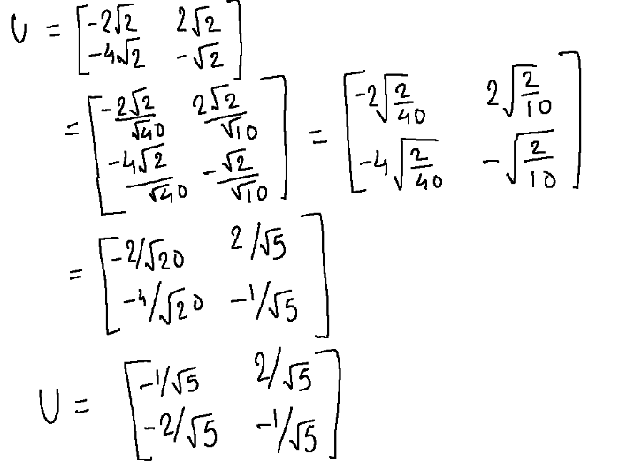
Working Example
Now, we need to convert this to unit vectors to get the final U matrix.

Slide 37
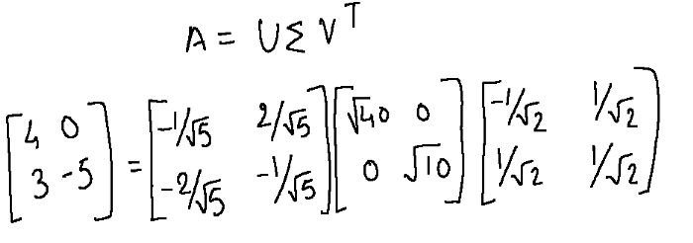
Working Example
So, there you go, we have calculated U, sigma and V and decomposed the matrix A into three matrices as given below.

Slide 38
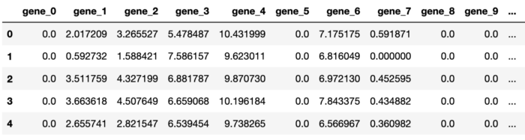
Implementation in python
SVD on gene expression dataset
The gene expression data set has 801 samples with each sample having 20531 gene data as columns.

Slide 39
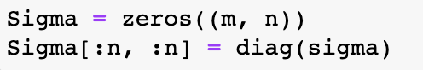
Implementation in python
Lets apply SVD on the dataset
sigma gives the singular values in an array. It has to be converted into matrix m x n matrix so that it can be used for data reduction and reconstruction.

Slide 40
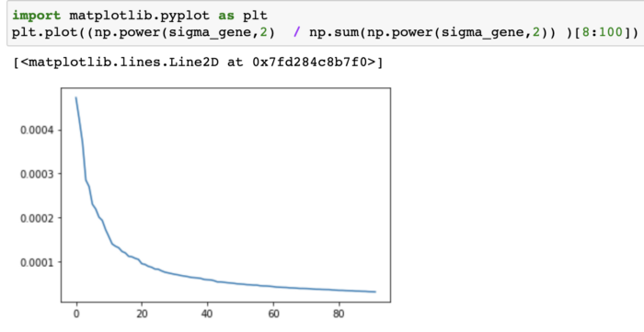
Implementation in python
When we plot the square of singular values by sum of squares of the all the singular values we see that, ignoring the first few values, most of the information can be retained by first few dimensions.

Slide 41
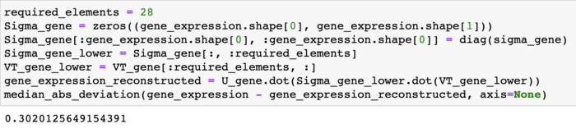
Implementation in python
Let’s try to reconstruct the original matrix by first 28 values and try to find the residual.
The median absolute deviation of the reconstructed value is pretty low considering the reduction in number of dimensions.

Slide 42
Advantage
It’s very efficient (via Lanczos algorithm or similar it can be applied to really big matrices).
The basis is hierarchical, ordered by relevance.
It tends to perform quite well for most data sets.

Slide 43
disAdvantage
If the data is strongly non-linear it may not work so well.
Results are not always the best for visualization.
It is difficult to interpret.
Strongly focused in variance, sometimes there’s not a direct relationship between variance and predictive power so it can discard useful information.

Slide 44
Summary
“SVD is not used to normalize the data, but to get rid of redundant data, that is, for dimensionality reduction. For example, if you have two variables, one is humidity index and another one is probability of rain, then their correlation is so high, that the second one does not contribute with any additional information useful for a classification or regression task. The eigenvalues in SVD help you determine what variables are most informative, and which ones you can do without.
The way it works is simple. You perform SVD over your training data (call it matrix A), to obtain U, S and V*. Then set to zero all values of S less than a certain arbitrary threshold call this new matrix S'. Then obtain A' = US'V* and use A' as your new training data. Some of your features are now set to zero and can be removed, sometimes without any performance penalty (depending on your data and the threshold chosen). This is called k-truncated SVD.”

Slide 45
MENU
ANALYSIS
CONTACT
Data ANALYSIS
Thank You

